Slide 1
E-retail factors for customer activation and retention: A case study from Indian e-commerce customers
Customer satisfaction has emerged as one of the most important factors that guarantee the success of online store; it has been posited as a key stimulant of purchase, repurchase intentions and customer loyalty. A comprehensive review of the literature, theories and models have been carried out to propose the models for customer activation and customer retention. Five major factors that contributed to the success of an e-commerce store have been identified as: service quality, system quality, information quality, trust and net benefit. The research furthermore investigated the factors that influence the online customers repeat purchase intention. The combination of both utilitarian value and hedonistic values are needed to affect the repeat purchase intention (loyalty) positively. The data is collected from the Indian online shoppers. Results indicate the e-retail success factors, which are very much critical for customer satisfaction.

Slide 2
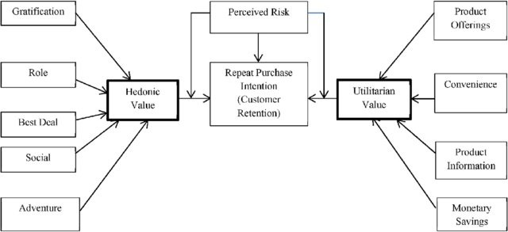

Slide 3
Problem Statement:
Customer retention
The customer retention is the process of engaging existing customers to continue buying products or services from the business.
Customer satisfaction
Customer satisfaction is a measurement that determines how happy customers are with a company’s products, services, and capabilities. Customer satisfaction information, including surveys and ratings, can help a company determine how to best improve or changes its products and services.
E-retail success.
How many happy customers does the particular e-retail website have.
Data Analysis.
Need to perform analysis on the data that has been provided and according to EDA, Visualization and other analysis, need to conclude the findings from analysis.

Slide 4
Understanding:
There are 2 excel sheets in the dataset that has been shared.
First, excel sheet is the detailed data of the e-retail website.
Second, excel sheet is the encoded data of the e-retail websites.
There are information of customers who do shopping online from different websites.
The information can be good as well as bad feedback for e-retail websites.
There are so many questions, polls and feedback columns in our dataset.
There are feedbacks & customer reviews of e-retail website such as:
Amazon.in
Flipkart.com
Myntra.com
Paytm.com and more.

Slide 5
EDA:
Shape of first dataset is 269, 71.
Shape of second dataset is also 269, 71.
Information of df1 datasheet.
RangeIndex: 0 to 268
Data columns: 71
dtypes: int64(1), object(70)
Information of df2 Datasheet.
dtypes: int64(46), object(25).

Slide 6
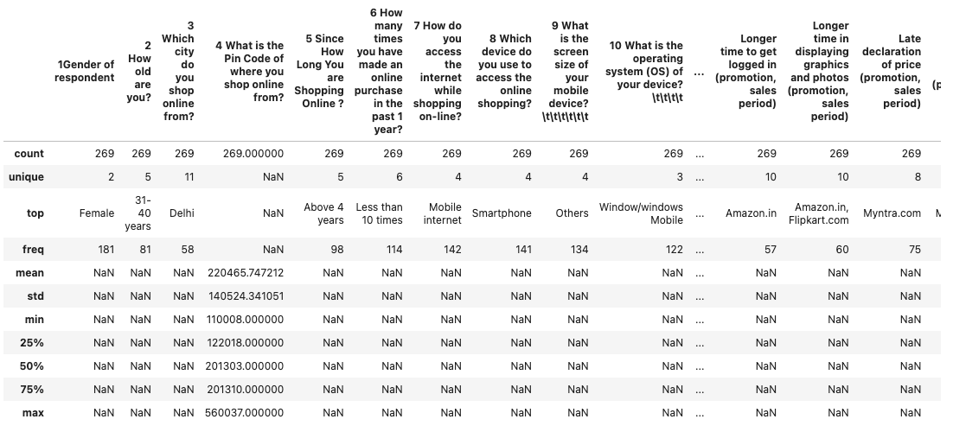
Descriptive Statistic:
First Dataset:

Slide 7
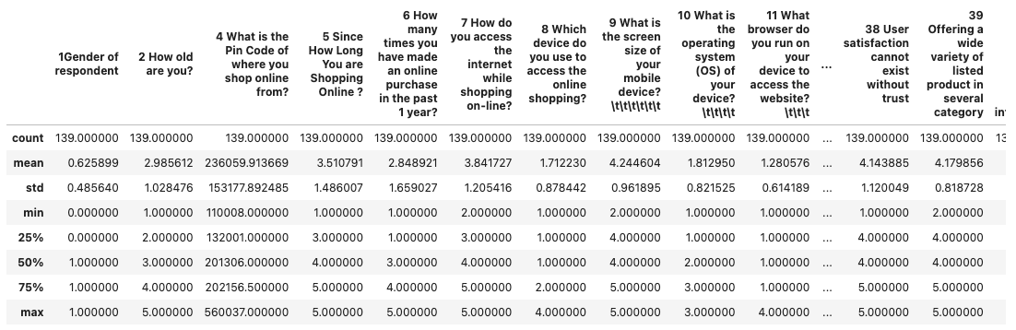
Second dataset:

Slide 8
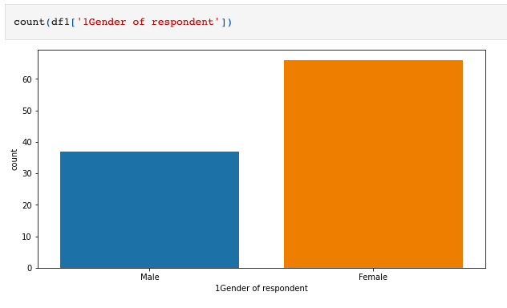
Female Customers are more than Male customer.

Slide 9
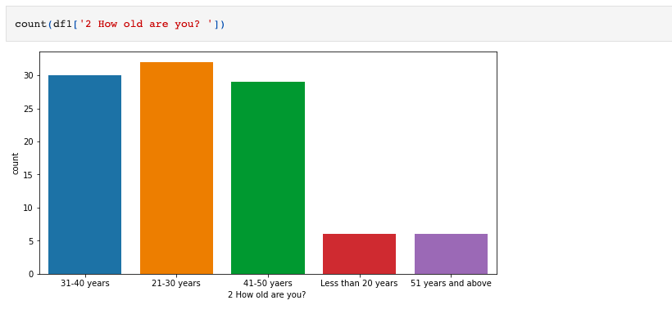
21-30 year customers, placed the highest amount of order.
31-40 years are the 2nd highest.
41-50 years customers are next.
Less than 20 & 51 years above, are the lowest.

Slide 10
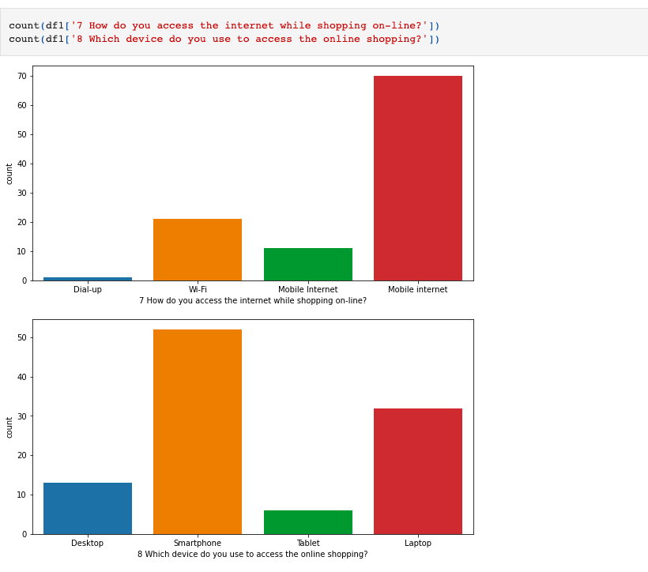
How do you access the internet while shopping on-line?.
1. Mobile Internet.
2. Wi-fi
3. Dial-up
Which device do you use to access the online shopping?
1. Smartphones.
2. Laptop.
3. Desktop.
4. Tablet.

Slide 11
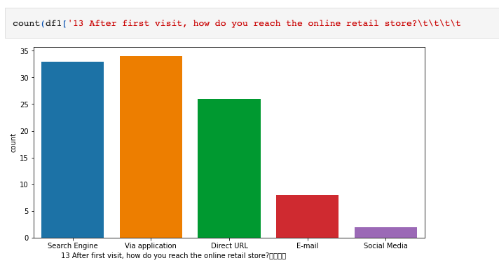
After first visit, how do you reach the online retail store?
1. Via Application.
2. Search Engine.
3. Direct URL.
4. E-mail.
5. Social Media.

Slide 12
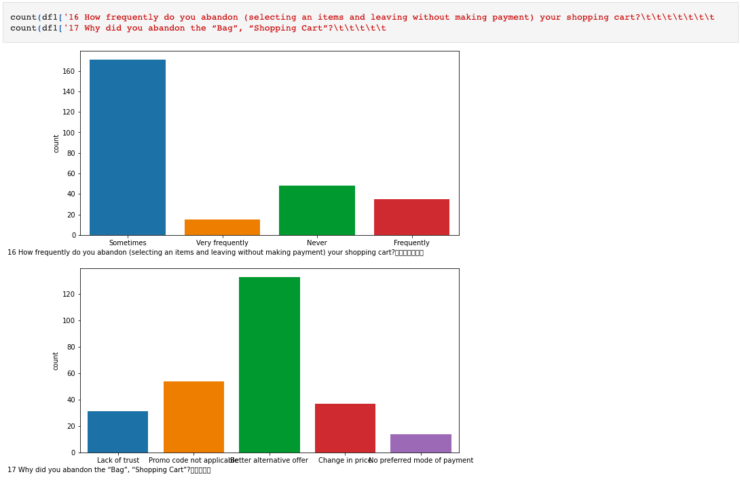
How frequently do you abandon (selecting an items and leaving without making payment) your shopping cart?
1. There are more number of customer, who abandon the shopping cart, Sometimes.
2. Never.
3. Frequently.
4. Very less number of customer abandon the shopping cart, very frequently.

Slide 13
Poll Columns:
'18 The content on the website must be easy to read and understand', '19 Information on similar product to the one highlighted is important for product comparison', '20 Complete information on listed seller and product being offered is important for purchase decision.', '21 All relevant information on listed products must be stated clearly', '22 Ease of navigation in website', '23 Loading and processing speed', '24 User friendly Interface of the website', '25 Convenient Payment methods', '26 Trust that the online retail store will fulfill its part of the transaction at the stipulated time', '27 Empathy (readiness to assist with queries) towards the customers', '28 Being able to guarantee the privacy of the customer', '29 Responsiveness, availability of several communication channels (email, online rep, twitter, phone etc.)', '30 Online shopping gives monetary benefit and discounts', '31 Enjoyment is derived from shopping online', '32 Shopping online is convenient and flexible', '33 Return and replacement policy of the e-tailer is important for purchase decision', '34 Gaining access to loyalty programs is a benefit of shopping online', '35 Displaying quality Information on the website improves satisfaction of customers', '36 User derive satisfaction while shopping on a good quality website or application', '37 Net Benefit derived from shopping online can lead to users satisfaction', '38 User satisfaction cannot exist without trust', '39 Offering a wide variety of listed product in several category', '40 Provision of complete and relevant product information', '41 Monetary savings', '42 The Convenience of patronizing the online retailer', '43 Shopping on the website gives you the sense of adventure', '44 Shopping on your preferred e-tailer enhances your social status', '45 You feel gratification shopping on your favorite e-tailer', '46 Shopping on the website helps you fulfill certain roles', '47 Getting value for money spent'

Slide 14
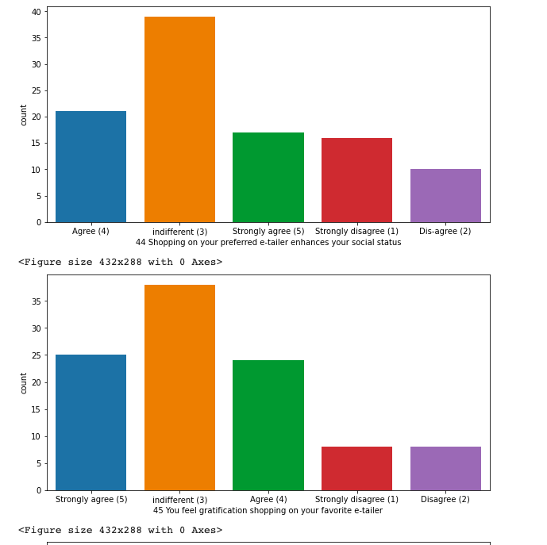
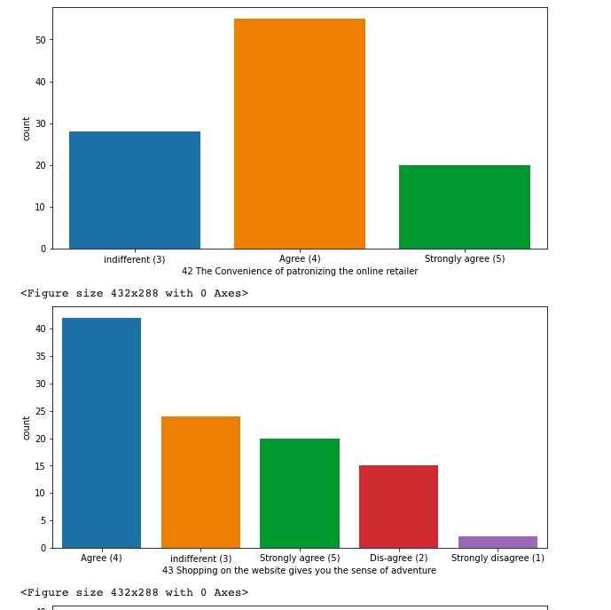
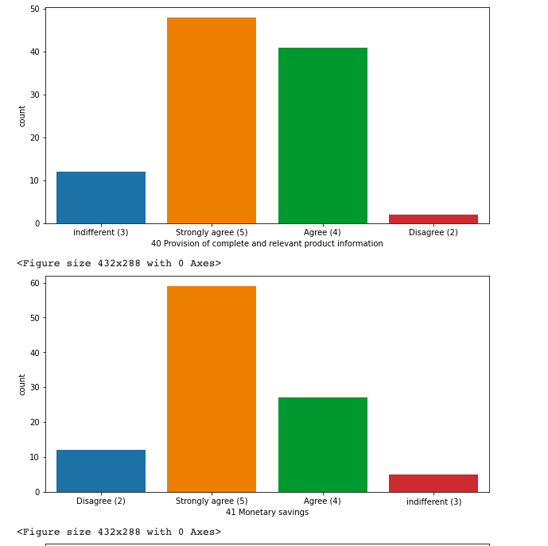
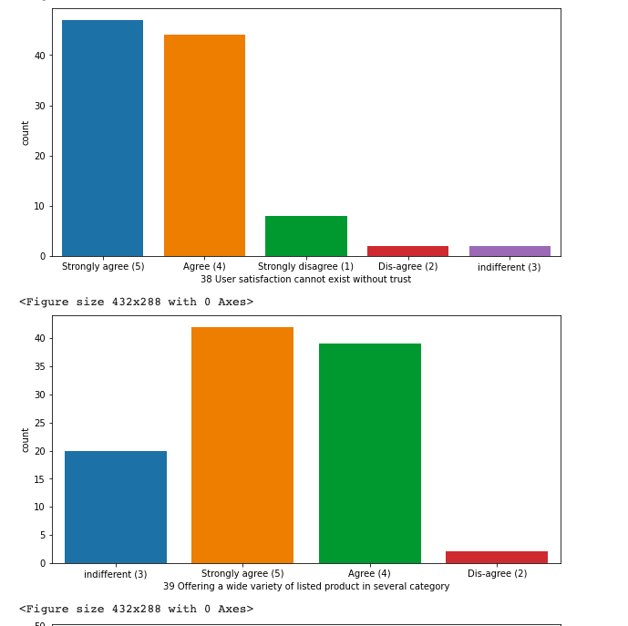
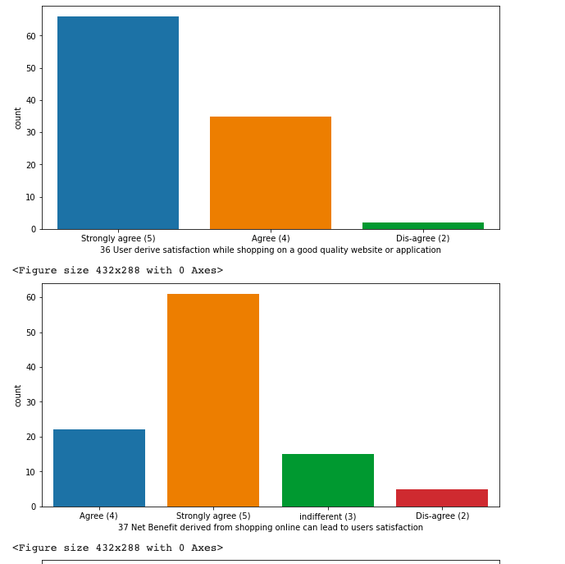
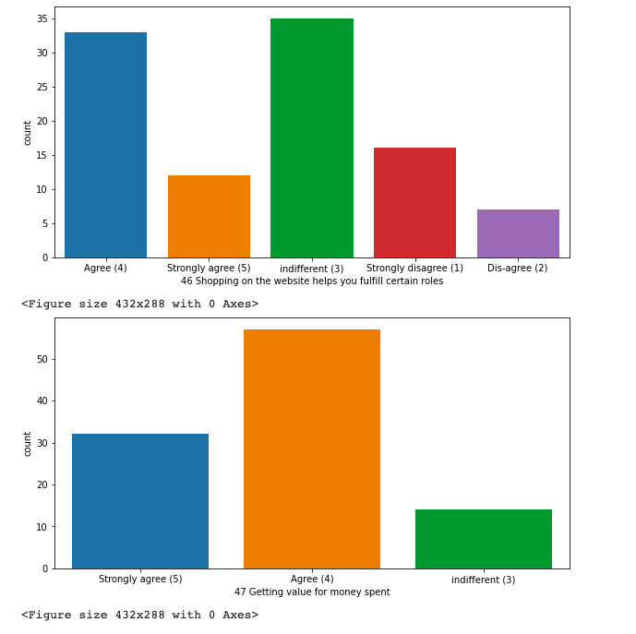
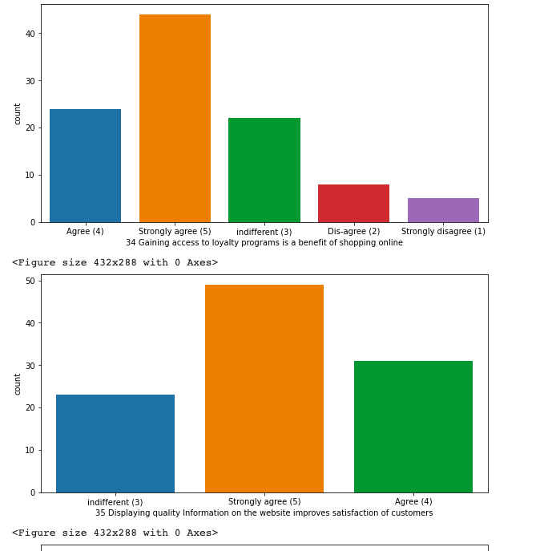

Slide 15
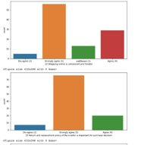
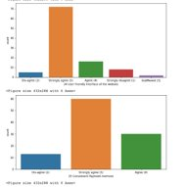
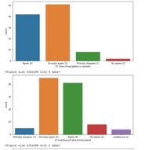
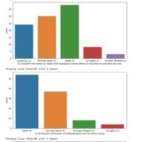
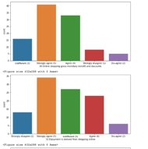
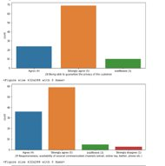
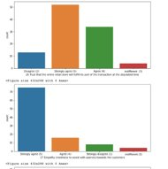
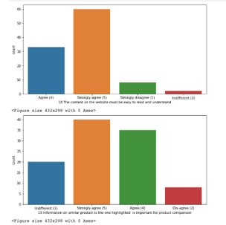

Slide 16
Strongly agree/Agree/Disagree/Strongly disagree/Indifferent Poll.
Strongly agree/Agree, can be considered as Agreed.
Disagree/Strongly disagree, can be considered as Disagree.
* All the columns in previous 2 slides are like the poll columns for the customers, where they have to agree or disagree with the question of poll with their own experience on website they shop at ... *
Most of the customers are agreed with the question and giving their opinions on the website.
There are very less number of customers who have voted for disagreed the conditions or question.
- In some of the columns the preference have been given to the Indifferent, like:
Shopping on your preferred e-tailer enhances your social status.
You feel gratification shopping on your favorite e-tailer.
Shopping on the website helps you fulfill certain roles.

Slide 17
Positive Feedback:
'From the following, tick any (or all) of the online retailers you have shopped from; ', 'Easy to use website or application', 'Visual appealing web-page layout', 'Wild variety of product on offer', 'Complete, relevant description information of products', 'Fast loading website speed of website and application', 'Reliability of the website or application', 'Quickness to complete purchase', 'Availability of several payment options', 'Speedy order delivery ', 'Privacy of customers’ information', 'Security of customer financial information', 'Perceived Trustworthiness', 'Presence of online assistance through multi-channel'

Slide 18
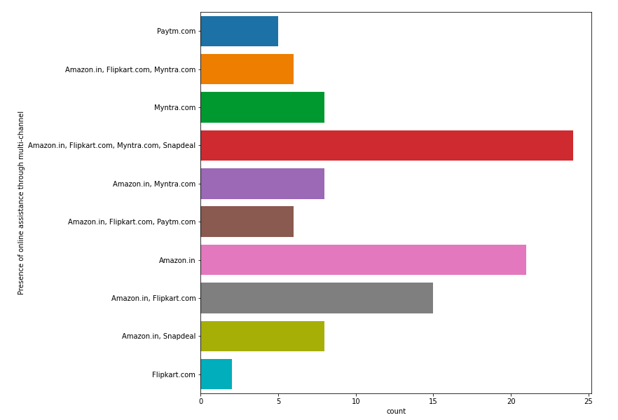
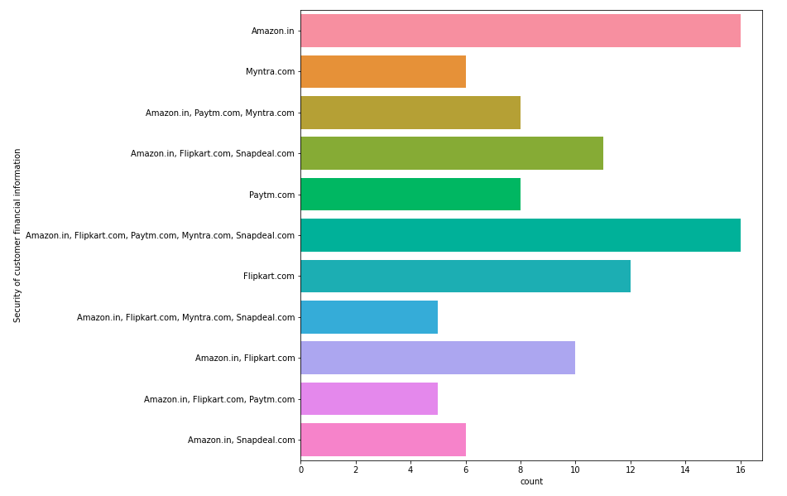
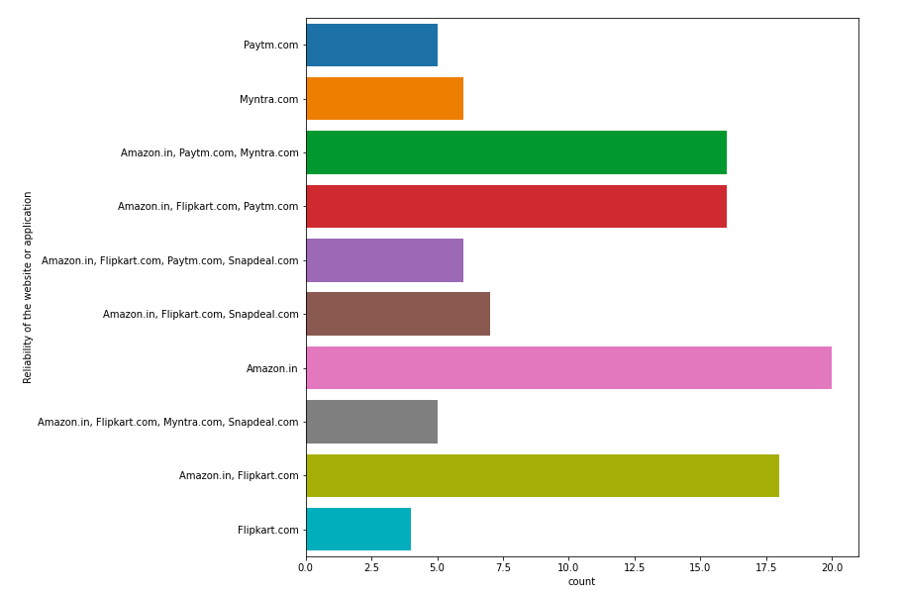
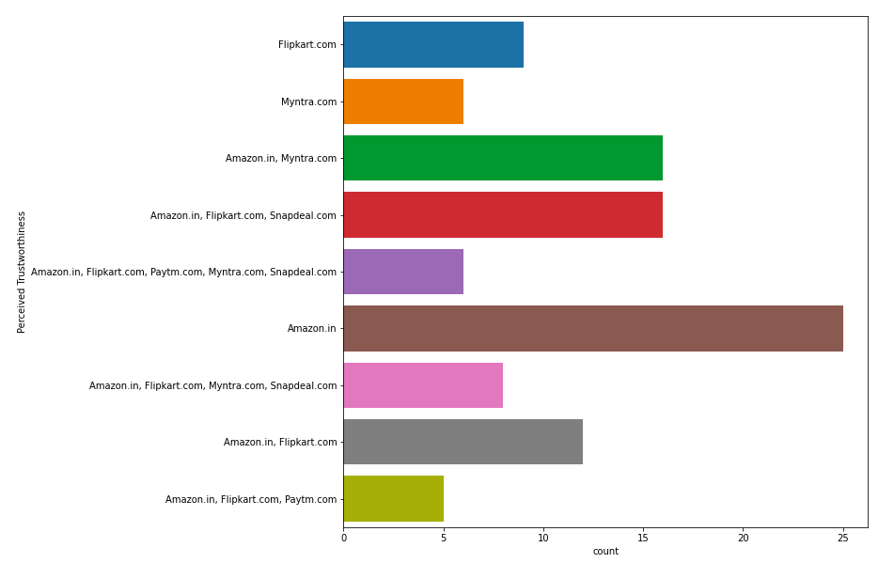
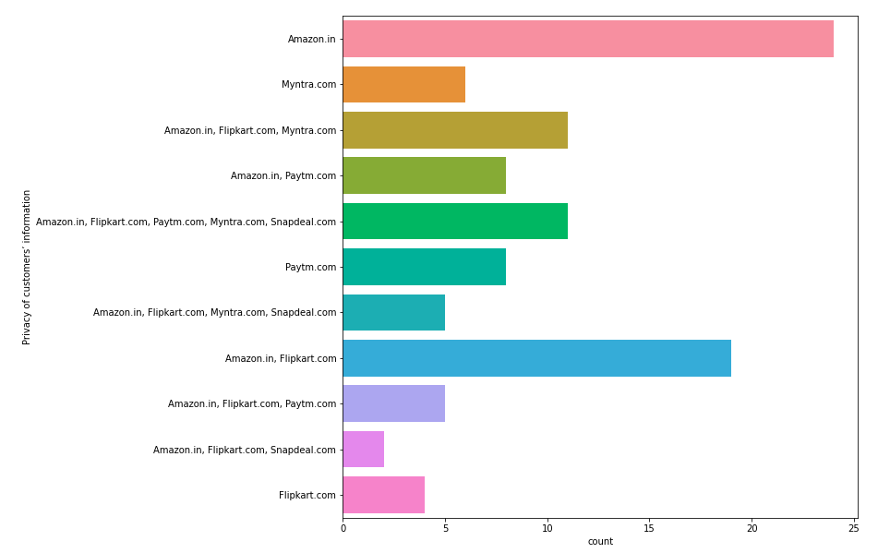
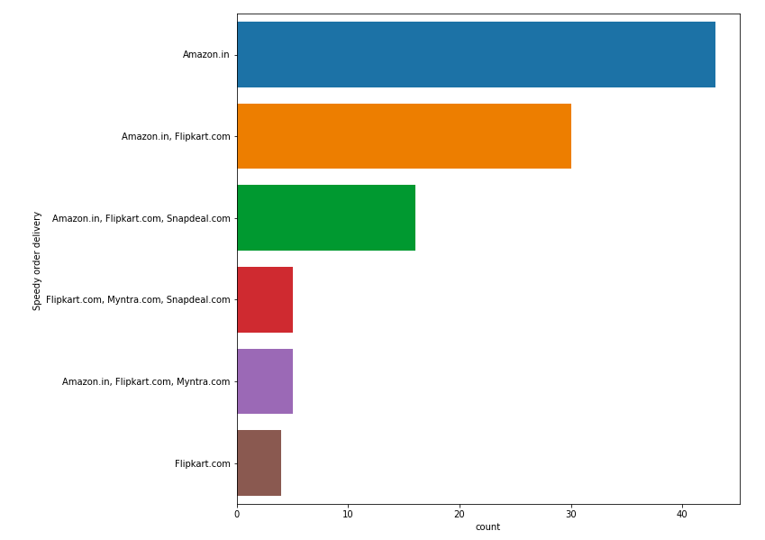
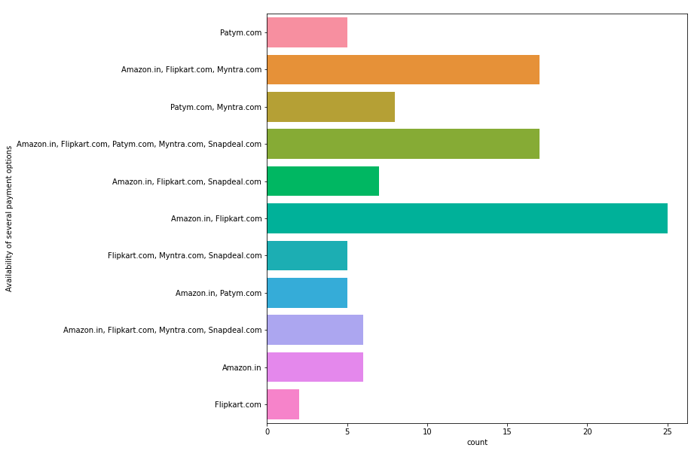
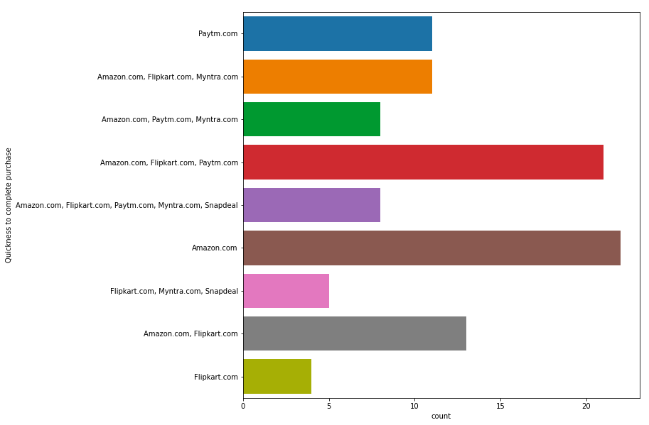

Slide 19
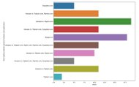
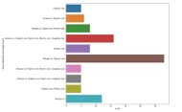
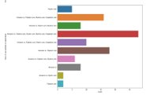
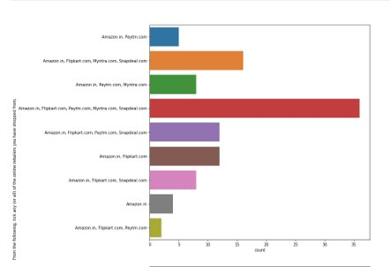
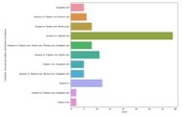
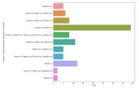
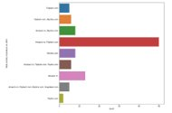

Slide 20
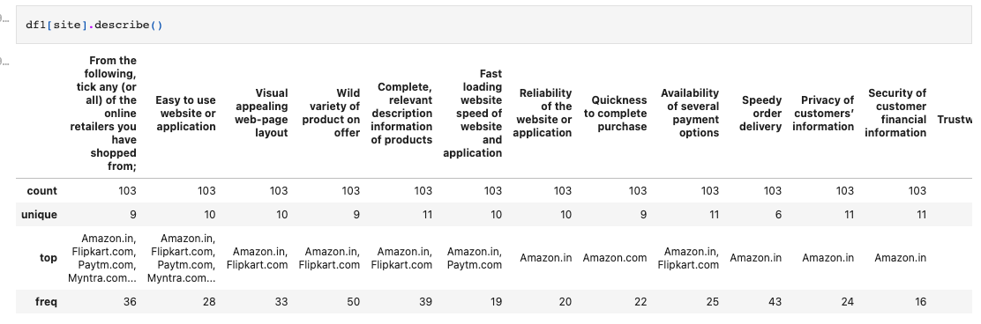
Questions, that can be considered as a Positive for the website.
Based on customers experience, they have voted for the website and these questions are the positive feedback for every website. - Amazon.in - Flipkart.com - Myntra.com are on the top in vote for every questions asked to the customers. So, we can considered that these websites are the shopping website, which is loved by customers, and having a lot of happy customers with it.

Slide 21
Negative Feedback:
'Longer time to get logged in (promotion, sales period)', 'Longer time in displaying graphics and photos (promotion, sales period)', 'Late declaration of price (promotion, sales period)', 'Longer page loading time (promotion, sales period)', 'Limited mode of payment on most products (promotion, sales period)', 'Longer delivery period', 'Change in website/Application design', 'Frequent disruption when moving from one page to another'

Slide 22
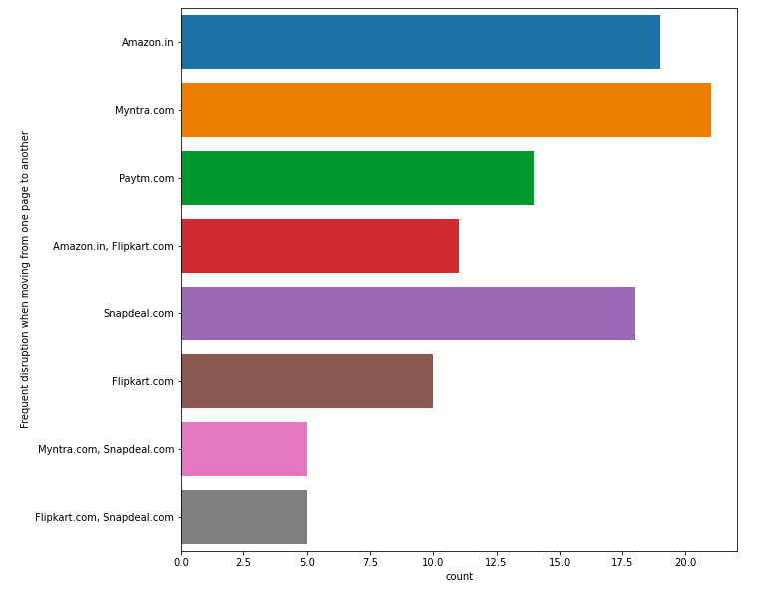
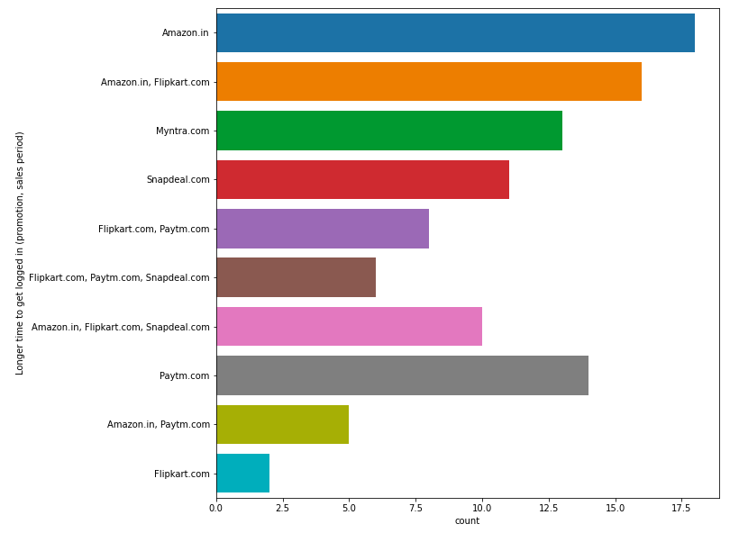
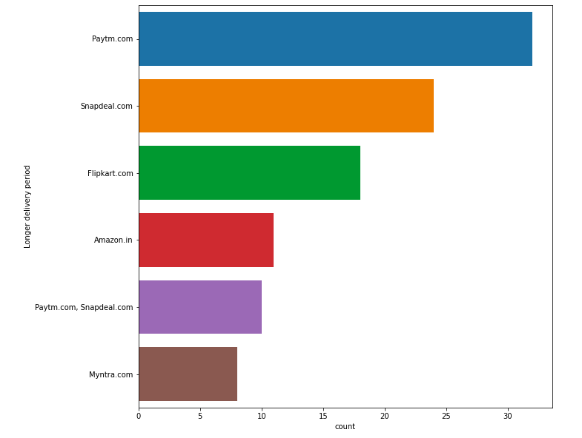
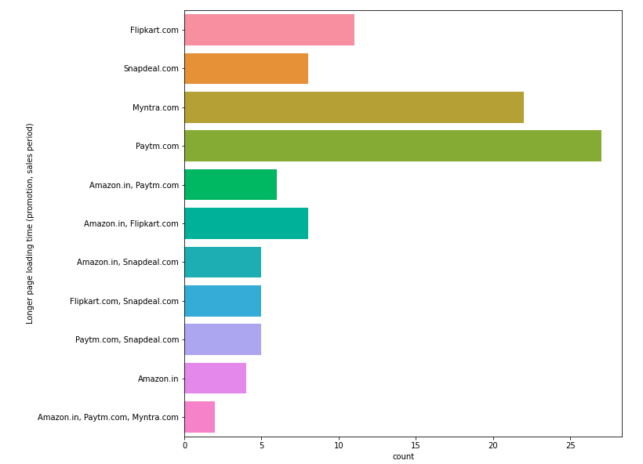
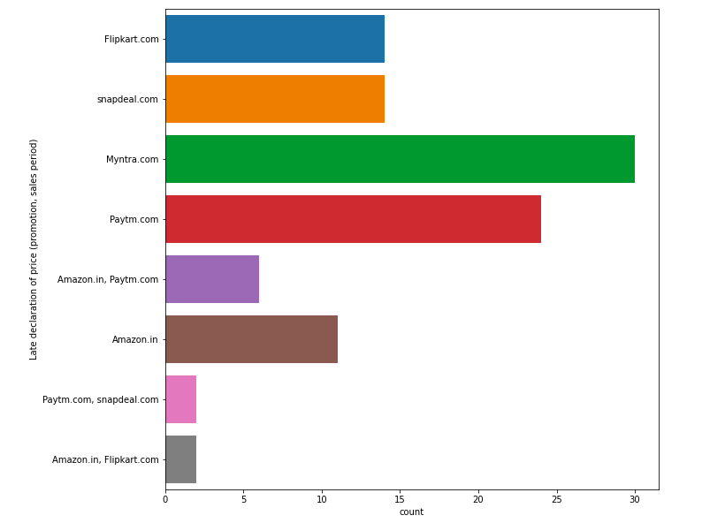
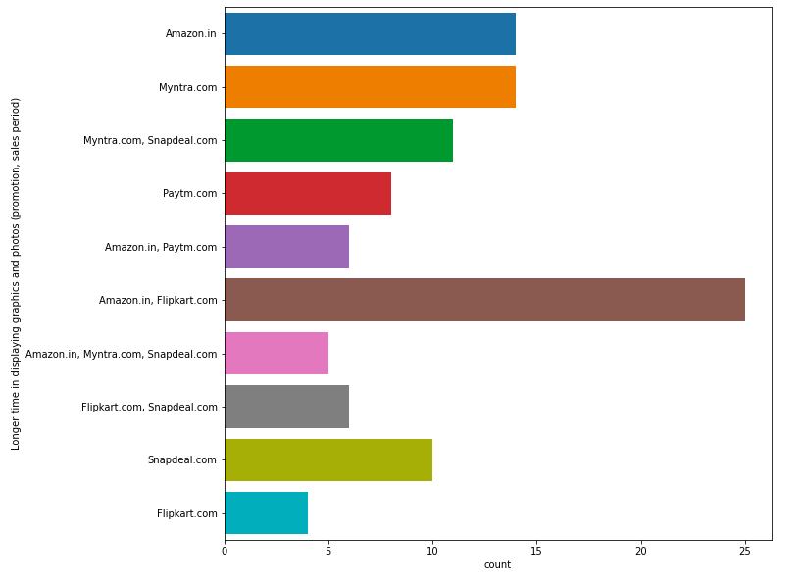
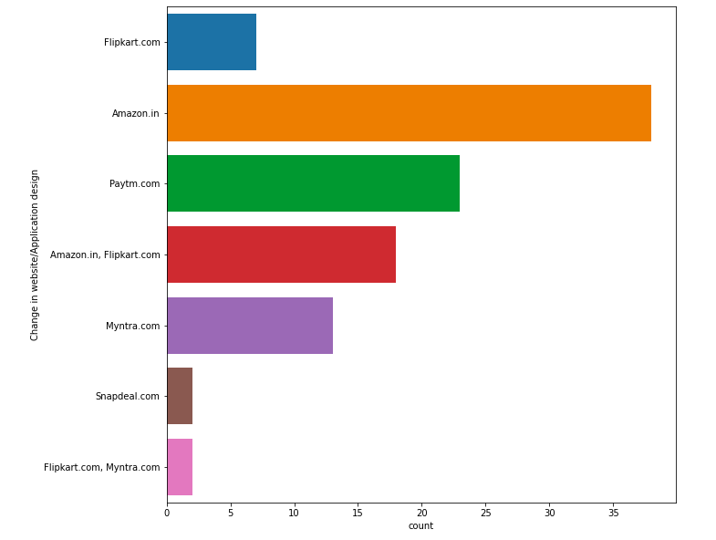
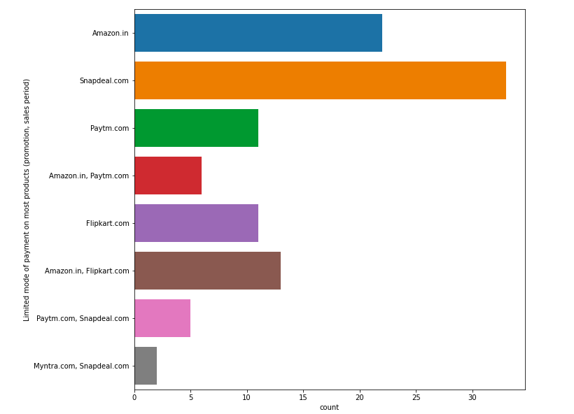

Slide 23
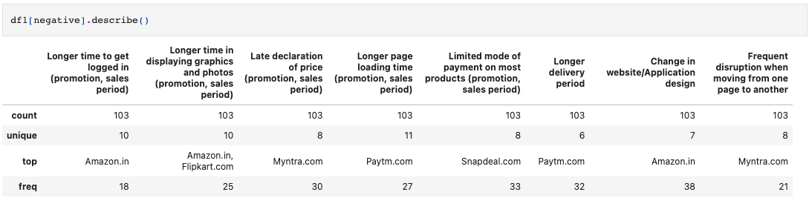
Questions, that can be considered as a Negative for the website.
Based on customers experience, they have voted for the website and these questions are the Negative feedback for every website. - Amazon.in - Flipkart.com - Myntra.com - Paytm.com are on the top in vote for every questions asked to the customers. So, we can considered that these websites are the shopping website, which has the most negative feedback by the customers. And have most of the negative feedback.

Slide 24
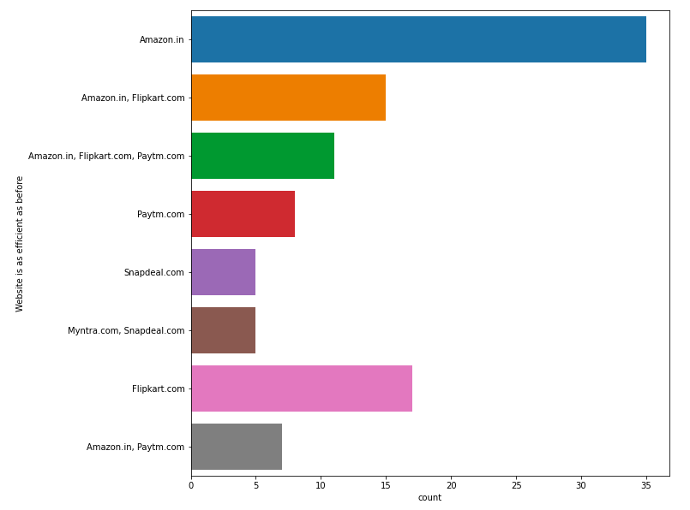
Website is as efficient as before
Positive for Website,
Amazon is still on the top and after that flipkart is there.

Slide 25
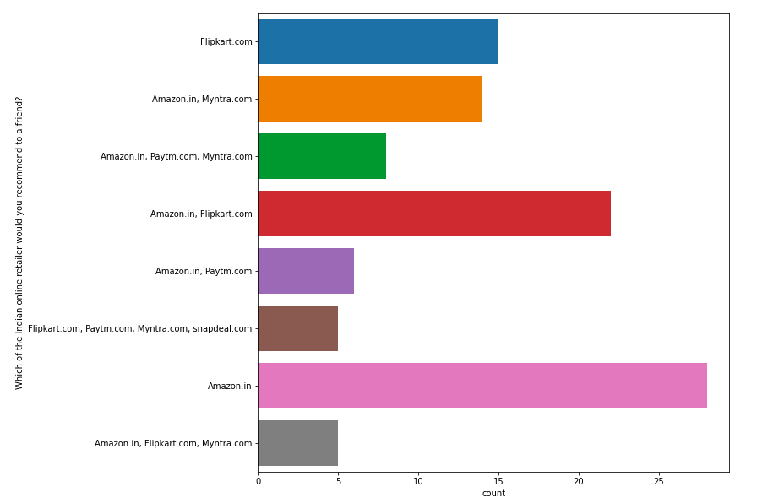
Which of the Indian online retailer would you recommend to a friend?
Amazon.in is the most recommended website, among all other website.
Myntra.com & Flipkart.com, are on the 2nd in recommendation

Slide 26

Which city do you shop online from?
1. Delhi
2. Greater Noida.
3. Noida.
4. Bangalore.
5. Karnal.
6. Solan & Ghaziabad.
7. Gurgaon.
8. Merrut.
9. Moradabad.
10. Bulandshahr.

Slide 27

What is the operating system (OS) of Customer's device?
1. Windows
2. Android.
3. IOS/Mac.

Slide 28


What is Customer's preferred payment Option?
1. Most of the customers, prefer the Credit/Debit cards option to make the payment on website for online shopping.
2. Cash on delivery(COD), comes next in preference of payment method.
3. E-wallets like paytm, freecharge etc, comes last on the preference.

Slide 29

There are multicollinearity problem present in our dataset. Most of the columns are correlated with each other.

Slide 30

Normal Distribution:

Slide 31

Outliers:

Slide 32
Normal Distribution & Outliers.
Almost all the columns are categorical columns as they are encoded ones. So we will be getting these kind of plots.

